Slide 1
Stories Worth Retelling:
How to Teach with Legends
Bryce Hedstrom
Roosevelt High School,
Johnstown, Colorado
brycehedstrom.com
ACTFL National Conference Denver, Colorado November 18, 2100

Slide 2
ACTFL STANDARDS
CULTURES Gain Knowledge and Understanding of Other Cultures
Standard 2.1: Students demonstrate an understanding of the relationship between the practices and perspectives of the culture studied
Standard 2.2: Students demonstrate an understanding of the relationship between the products and perspectives of the culture studied

Slide 3
"If you want your children to be intelligent, read them fairy tales. If you want them to be more intelligent, read them more fairy tales."

Slide 4
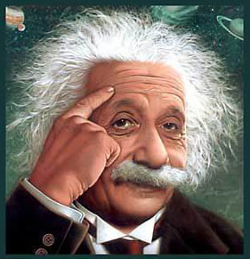
"If you want your children to be intelligent, read them fairy tales. If you want them to be more intelligent, read them more fairy tales."
— Albert Einstein

Slide 5
Pick a Worthwhile Story

Slide 6
Pick a Worthwhile Story
Ideally, it should be:
Familiar in the culture
Used for different purposes
Something with staying power

Slide 7
Pick a Worthwhile Story
Familiar in the culture
• Everybody tells it
• Contains cultural themes

Slide 8
Pick a Worthwhile Story
Used for different purposes
• Expresses values of the culture
(Not just an interesting story)
• Is adaptable

Slide 9
Pick a Worthwhile Story
Something with staying power
• We want to hear it again
• Has deeper subtext
(subliminal messages)

Slide 10
It’s OK to tell it again!
Spoilers don't ruin stories or films: study
A new study by researchers from the University of California at San Diego shows the plot itself isn't critical.
A book or movie can be re-read or seen multiple times and still be enjoyable.
The success of entertainment does not rest on suspense alone.

Slide 11
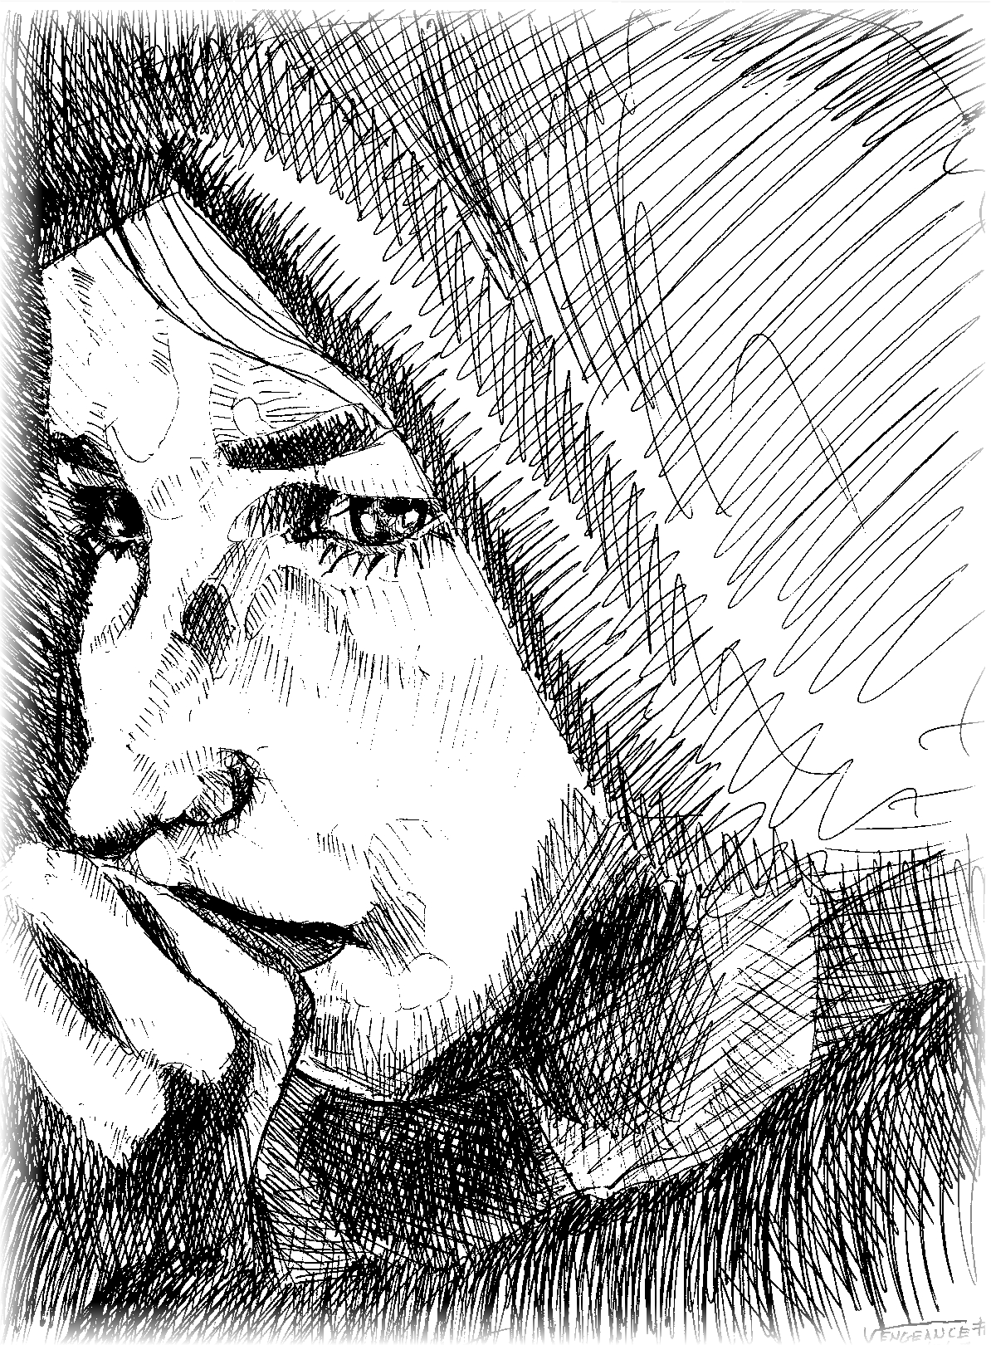
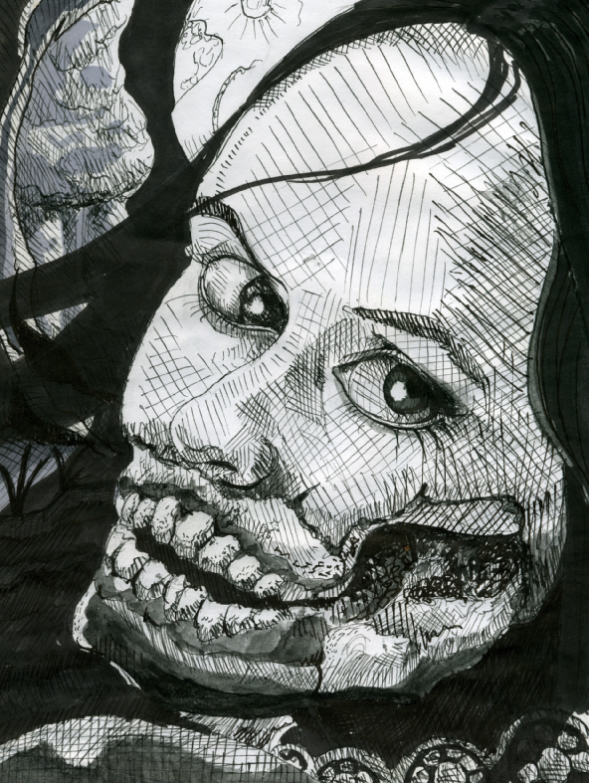
Legends

Slide 12
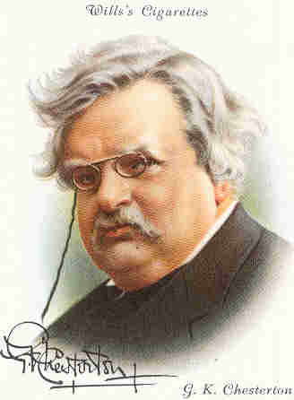
Legends
"It is quite easy to see why a legend is treated, and ought to be treated, more respectfully than a book of history. The legend is generally made by a majority of the people in the village who are sane. The book is generally written by the one man in the village who is mad."
G.K. Chesterton, Orthodoxy

Slide 13
Legends are stories created by anonymous authors with some basis in history but with many embellishments. Legends show us the vision of the world and the life that people had with, historical, political, philosophical, and cultural value.

Slide 14
Myths
Myths are stories that explain the origin of gods or of the creation of our world. They usually show us religion, beliefs or try to explain natural phenomena.

Slide 15
Telling a Legend
Start with a simple version
(We listen for meaning first, details later)
Teach vocabulary
Retell with more detail, answering questions along the way.
More detail makes it more interesting
Details are important, but we can’t hear details at first.

Slide 16
Initial Telling
NEW VOCAB FAMILIAR VOCAB
woman children
husband goes away
seems like is sad
they die/she dies river
returns pushes
keeps on yelling water
keeps on crying night
keeps on looking for beside

Slide 17
Don’t forget what you already know about telling stories to students:
• Stay in bounds (Don’t use words they don’t know)
• Teach to the eyes (You can see if they get it)
• Use your voice
“High, low; fast, slow; loud, soft; pause”
Mem Fox—Reading Magic
• Build anticipation
“Pero hay un problema…”
But there is a problem…
“Pero esto no es el fin del cuento…”
But this is not the end of the story…

Slide 18
The legend of La Llorona is not just an interesting story—it displays values in Hispanic culture
What are some possible values that are being taught in this story?

Slide 19
Tell low, test high.
Tell the story in a comprehensible way, using simple words that students know. Assess it with higher order thinking.
Use English, if needed for, higher order thinking that the students may not have words for yet.

Slide 20
The Cry
DVD about the legend of La Llorona
Directed by Bernadine Santistevan
Lallorona.com

Slide 21
Ixta y Popo
La Calle de la Quemada
Bailando con una Fantasma
Compartiendo con la Muerte

Slide 22
TIME TO PROCESS!
Think of a legend from your target culture that you could tell with limited vocabulary
How can you simplify it?
Adapt it with high frequency words
Use pre-existing vocabulary
Use no more than 8 new words/structures
Write it down

Slide 23
Any story, but especially a legend, can be told on many different levels—level I to AP
Keep spiraling up and out with each re-telling

Slide 24
Keep Trying!
The Pareto principle (also known as the 80-20 rule) states that for many events roughly 80% of the effects come from 20% of the causes. 80% of the plans will not work.
The point is to keep trying: Without the 80% of the plans that fail, the 20% of the plans that succeed would not succeed.

